Slide 1
FYP DEMO Machine Learning and Data Fusion For An Intelligent Wearable Device
Galada Aditya
U1422406K

Slide 2
Outline
1. ECG R Peak Detection
2. ECG Signal Processing and Analysis
3. Respiratory Rate Estimation
4. Adaptive Filtering of ECG
5. Bio Signal Based Age Classification
6. Heart Sound Anomaly Classification

Slide 3
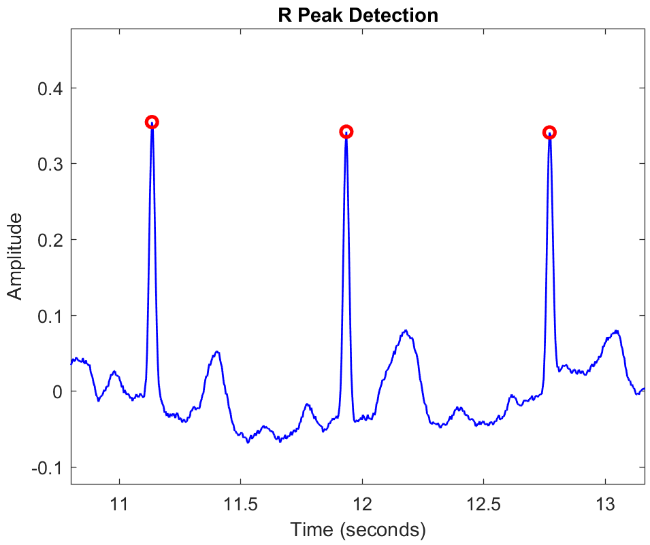
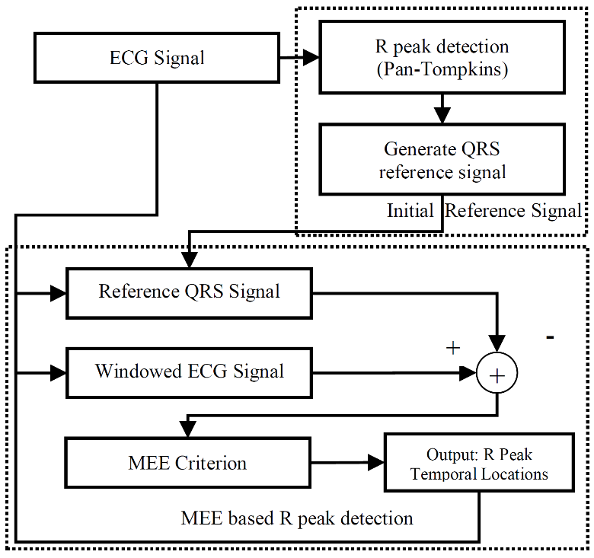
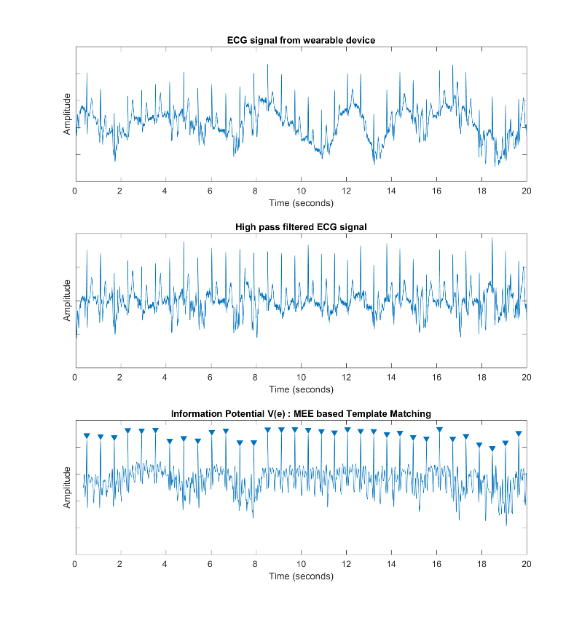
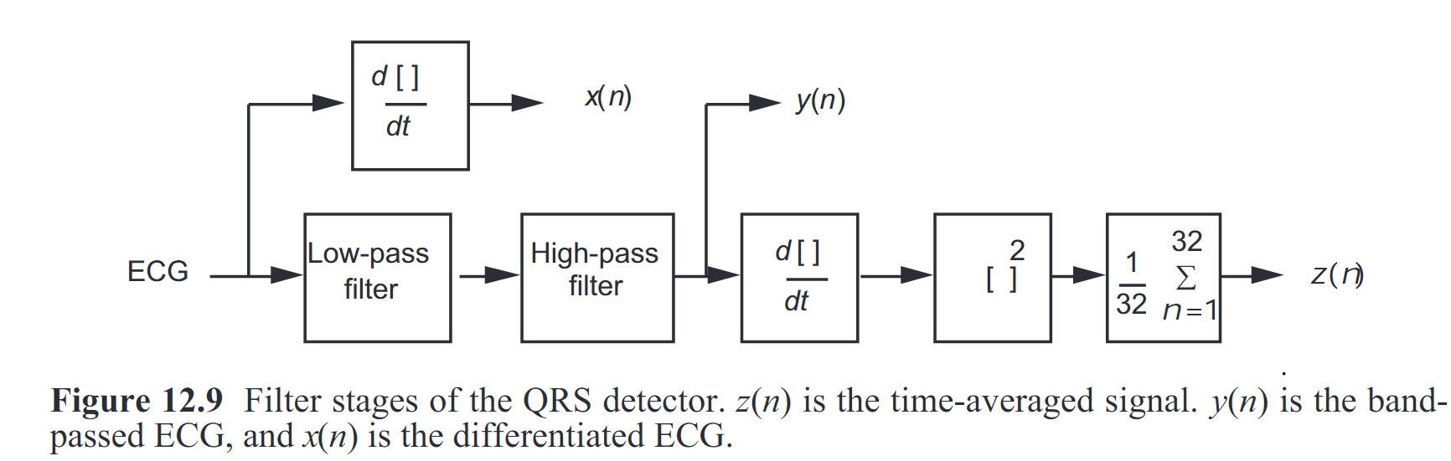
ECG R Peak Detection
1. R Peak Detection
3. Proposed MEE Scheme
4. Results
ECG – electrical voltage produced by cardiac muscle contraction and expansion.
R peaks – reference marker for each cycle
Accurate detection important – rhythm analysis
 | Acc – MEE | Acc - PT | Improvement
1 | 99.479 | 99.577 | 0.098
2 | 90.700 | 97.686 | 6.986
3 | 90.647 | 96.093 | 5.446
4 | 88.178 | 91.264 | 3.086
5 | 91.538 | 96.049 | 4.511
6 | 98.843 | 98.442 | -0.402
7 | 98.346 | 99.322 | 0.976
8 | 83.336 | 84.911 | 1.576
9 | 94.031 | 95.970 | 1.940
10 | 99.509 | 99.111 | -0.398
11 | 94.970 | 96.379 | 1.409
12 | 97.398 | 97.368 | -0.030
TOTAL | 93.950 | 95.979 | 2.028
2. Pan Tompkins Algorithm
MEE criterion aims to minimize the entropy of error between measured and desired signal
Initial reference signal - averaging the QRS complexes detected by PT method.
Measured input signal - windowed noisy ECG.
The QRS complex is slid across the ECG signal and the cost function at each step is recorded and the reference signal is regularly updated.
Peaks in this plot correspond to ECG R peaks.
Traditionally used method – PT algorithm
Filtering – Differentiation – Squaring – Integration
Susceptible to muscle and motion noise
Overall improvement in accuracy
FP beats reduce : 3122 for PT , 1447 for MEE.
Acc. improve by 6.9% for patient 2, noisy signal.

Slide 4
ECG Signal Processing and Analysis
1. Cardiac Rehab
Blood pressure decreased and heart rate increased after rehab
Target heart rate was met – in general
Limitation – single point readings
3. ECG Monitoring Results – Cont’d
Data collected from 12 patients undergoing cardiac rehabilitation exercises.
Prescribed 3 exercises – TM SC AC/IR
Program Structure
Warmup : Ex1 : Rest : Ex2 : Rest : Ex3 : Cool down
2 Methods of data collection
Intermittent physiological monitor
Wearable device with ECG sensors
3. ECG Monitoring Results
2. Conventional Monitors
No | Target HR (bpm) | TM | SC | AC/IR | AC/IR | Pre-rehab | Post-rehab
 |  | Exercise HR (bpm) |  |  |  | Blood Pressure(mm Hg) HR (bpm)
1 | 90~100 | 94 | 96 |  | 103 | 114/64, 71 | 107/65, 76
2 | 100~105 | 94 | 98 |  | 104 | 120/59, 60 | 108/50, 62
3 | 85~90 | 84 | 89 |  | 82 | 117/61, 62 | 103/58, 74
4 | 100~110 | 105 | 111 |  | 95 | 131/81, 68 | 104/68, 87
5 | 90~95 | 72 | 82 |  | 83 | 153/75, 56 | 113/60, 60
6 | 95~100 | 117 | 105 |  | 86 | 133/86, 65 | 123/73, 73
7 | 102~110 | 90 | 103 |  | 113 | 148/66, 72 | 123/67, 76
8 | 80~85 | 107 | 105 |  | 95 | 102/65, 77 | 103/58, 79
9 | 70~80 | 77 | 74 |  | 66 | 126/60, 56 | 122/68, 58
10 | 85~90 | 100 | 87 |  | 85 | 137/70, 66 | 135/65, 70
11 | 110 | N.A. | 105 |  | 94 | 149/65, 61 | 138/64, 94
12 | 100 | 105 | 92 |  | 87 | 152/89, 70 | 138/60, 78
Exercise wise analysis
Patient 1,7 assigned IR have higher mean HR and lower sdHR than other exercises. => is intensive and requires a consistent effort.
8/10 patients assigned AC have lower HR than other exercises. => intensity of this exercise is relatively lower.
ECG monitoring adds value to rehab exercise.
R Peak detection performed
Inter-beat interval calculated
Plot of heart rate vs time obtained
Closely reflects the exercise regimen
More detailed and continuous information
Publication : Aditya Galada, Jianmin Zhang, Yong Kiang Yeo, Wee Ser, Zhiping Lin, Doris Tan, Yvonne Chow, Swapna Tony, Jaclyn Chow and David Foo, “ECG Signal Processing and Analysis for Data Arising from Rehab Patients Doing Exercises,” IEEE ISCAS 2018, Florence, Italy, May, 2018, accepted.

Slide 5
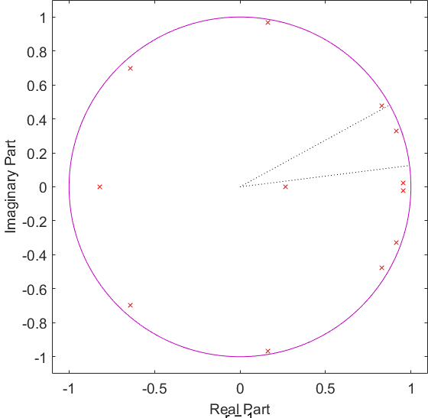
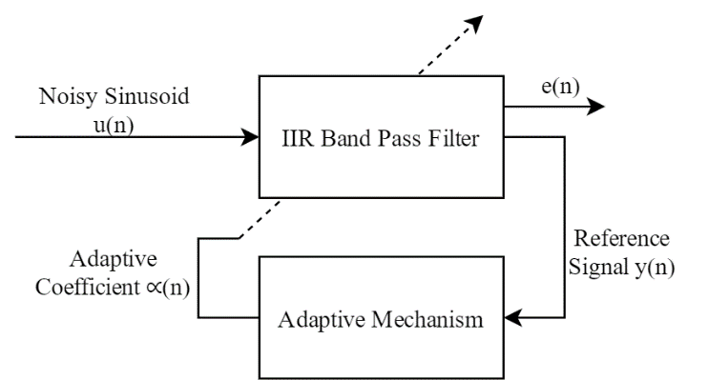
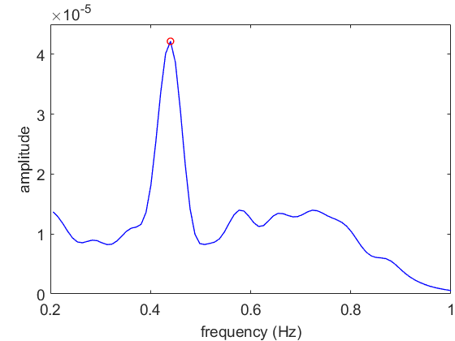
Respiratory Rate Estimation
1. RSA
3. Autoregressive model
4. Instantaneous Frequency Tracking
Respiratory rate – important vital sign
Direct respiration rate measurement – difficult
Possible to derive respiration from ECG
Heartbeat intervals increase during inhalation, decrease during exhalation
2. Power Spectrum
Instantaneous Frequency Tracking
Use of an adaptive filter.
Weights of IIR bandpass filter recursively updated.
Window the ECG signal into 30 minute sections
Shift of 5 seconds between successive windows
Generate the autoregressive model of ibi series
Dominant pole -> respiratory frequency
Limitations of PSD and AR
- Use window, do not give instantaneous values
- Cannot track the RR rate closely
6. Result
Refer to plots in MATLAB GUI
Window the ECG signal into 1 minute sections
Shift of 10 seconds between successive windows
Obtain power spectrum plot of ibi
Peak power -> respiratory frequency

Slide 6
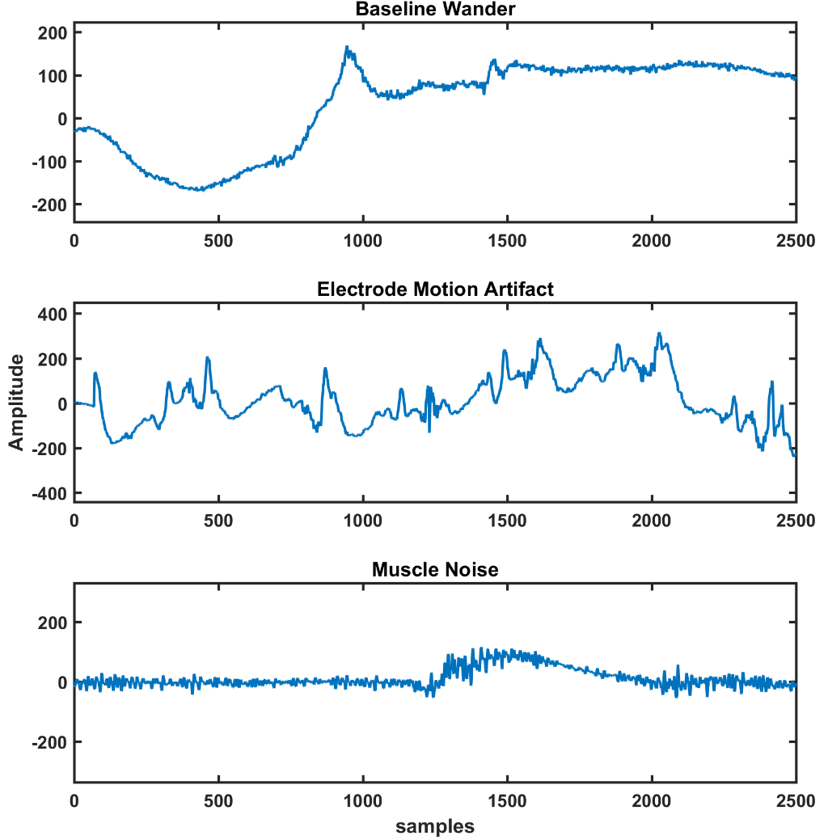
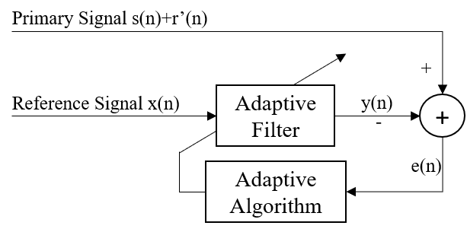
Adaptive Filtering of ECG Signal
1. Noise Cancellation Setup
2. Noise Simulation
4. Result
Baseline Wander Removal
Input SNR dB | MEE Improvement dB | LMS Improvement dB
-6 | 24.9303 | 19.9502
-3 | 22.7115 | 19.2311
0 | 20.2217 | 18.3487
3 | 17.5369 | 17.4543
6 | 14.7202 | 16.5423
Electrode Motion Artifact Removal
Input SNR dB | MEE Improvement dB | LMS Improvement dB
-6 | 24.9303 | 19.9502
-3 | 22.7115 | 19.2311
0 | 20.2217 | 18.3487
3 | 17.5369 | 17.4543
6 | 14.7202 | 16.5423
Adaptive filtering for noise cancellation
Primary Signal – noise contaminated ECG
Reference Signal – corelated only with noise
Possible to adaptively model the noise in ECG and cancel it with help of a secondary reference.
Try two algorithms – Minimum Error Entropy and Least Mean Square
Muscle Noise Removal
Input SNR | MEE Improvement | LMS Improvement
-6 | 19.7953 | 19.0408
-3 | 18.6016 | 17.9184
0 | 17.3917 | 16.7865
3 | 15.9326 | 15.6144
6 | 14.3588 | 14.4536
3 types of noise obtained from MIT – NSTDB
Experiments performed using MEE and LMS algorithms at SNR [-6 -3 0 3 6] dB
MEE found to outperform in cases of poor signal quality (low SNR)

Slide 7
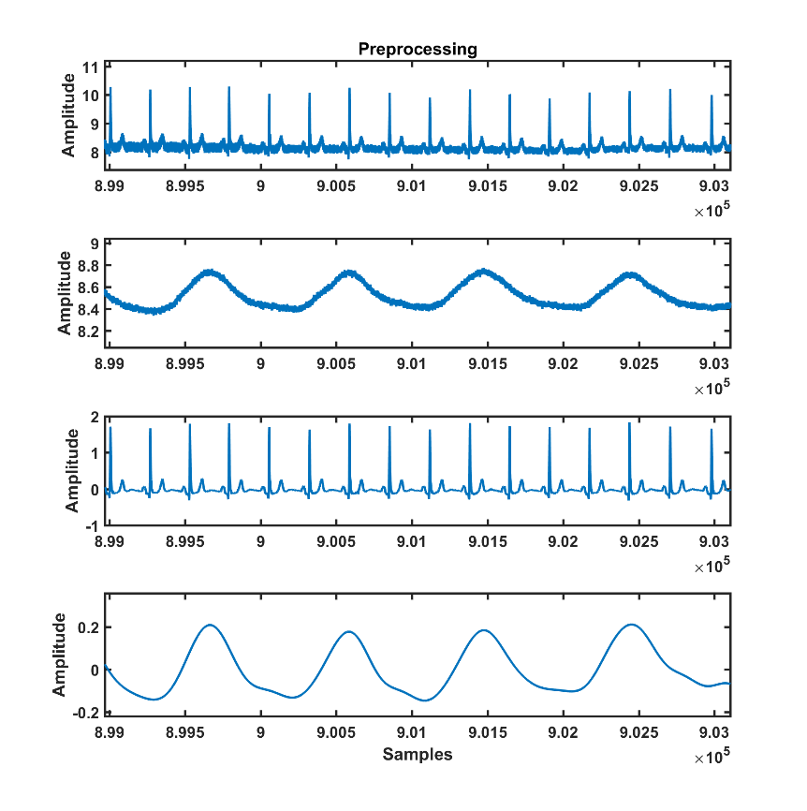
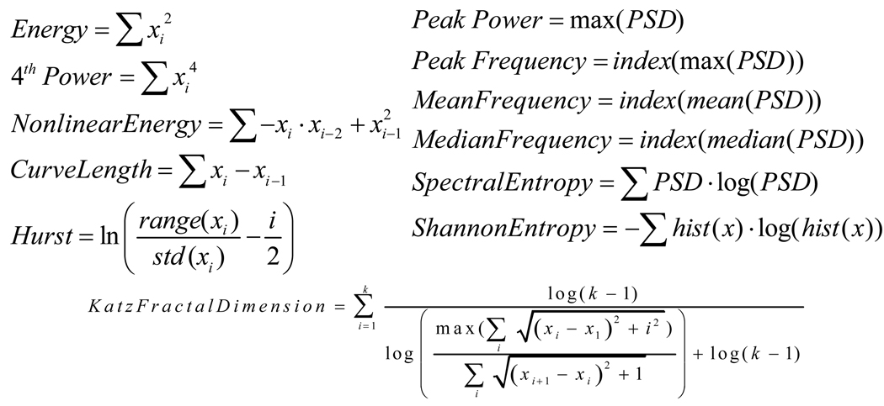
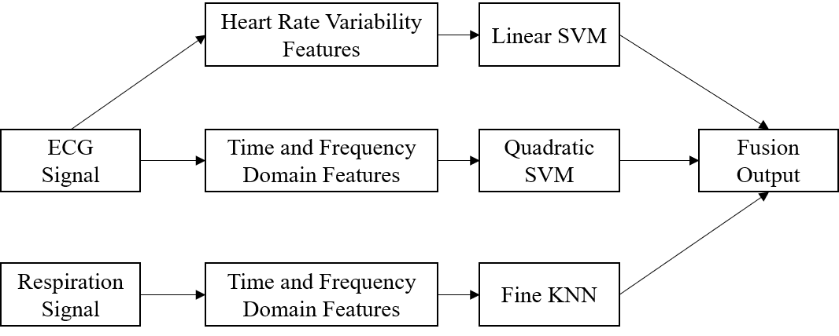
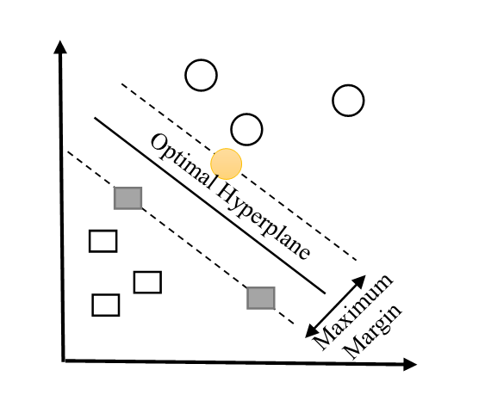
Bio Signal Based Age Classification
1. Pre-processing
2. Feature Extraction
4. Classification Model - KNN
Training Instance
Class 1
Distance
K=3
Class 2
?
K=1
New Example
5. Data Fusion Scheme
Extraction of HRV features from ECG Signal
Motive – known that HRV decreases with age
3. Classification Model - SVM
Use of ECG and Resp. signal for age prediction
Data obtained for 40 patients from Fantasia Database. 20 young, 20 old
Pre-processing – use of FIR bandpass filters
6. Result
Refer to plots in MATLAB GUI

Slide 8
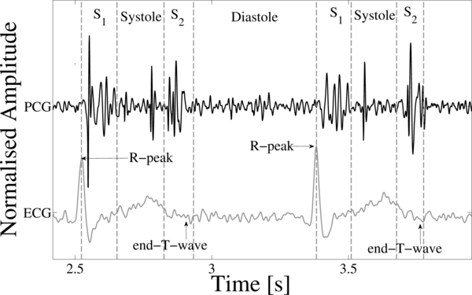
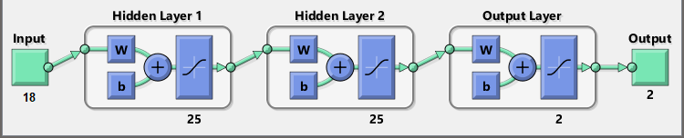
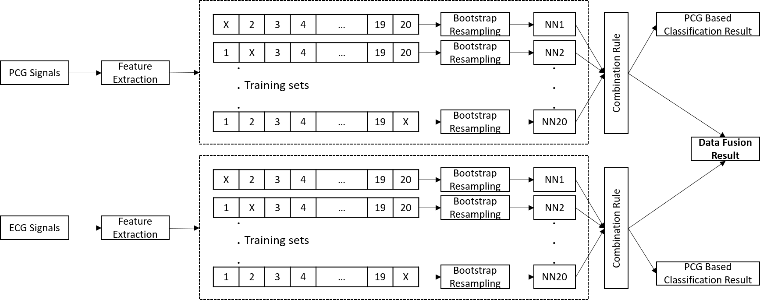
Heart Sound Anomaly Classification
1. Input Signal
3. Ensemble of Neural Network
2. Feature Extraction
4. Results
Total of 18 features extracted :
Linear Predictive Coefficients
Entropy Based Features
Wavelet Transform
Power Spectrum Features
Mel Frequency Cepstral Coefficients
 | PCG Feature Based Classifier |  |  | ECG Feature Based Classifier |  |  | Data Fusion
 | Se % | Sp % | Acc % | Se % | Sp % | Acc % | Se % | Sp % | Acc %
Mean | 76.094 | 87.112 | 83.250 | 79.812 | 86.803 | 85.000 | 75.855 | 93.732 | 88.750
SD | 13.131 | 5.058 | 6.329 | 16.764 | 6.658 | 5.244 | 16.831 | 2.054 | 6.149

